Slide 1


CZ2004
Human Computer Interaction
Example Class 4-5 Hi-Fi Prototype (DSAI1)
Hi-Fi Prototype Owner: Josephine Agatha Hemingway (Seat 11) Reviewer: Joey Lim Soo Yee (Seat 10)
Play the prototype on Slide Show
Click on interactive buttons only when instructed to
Click exactly where the buttons are
- Everything is done solely on powerpoint -

Slide 2




1. Welcome Screen
Welcome page pops up upon opening the app, transiting to the home page immediately
Click to continue
Welcome to
iNavigate
AN INDOOR NAVIGATION SYSTEM

Slide 3

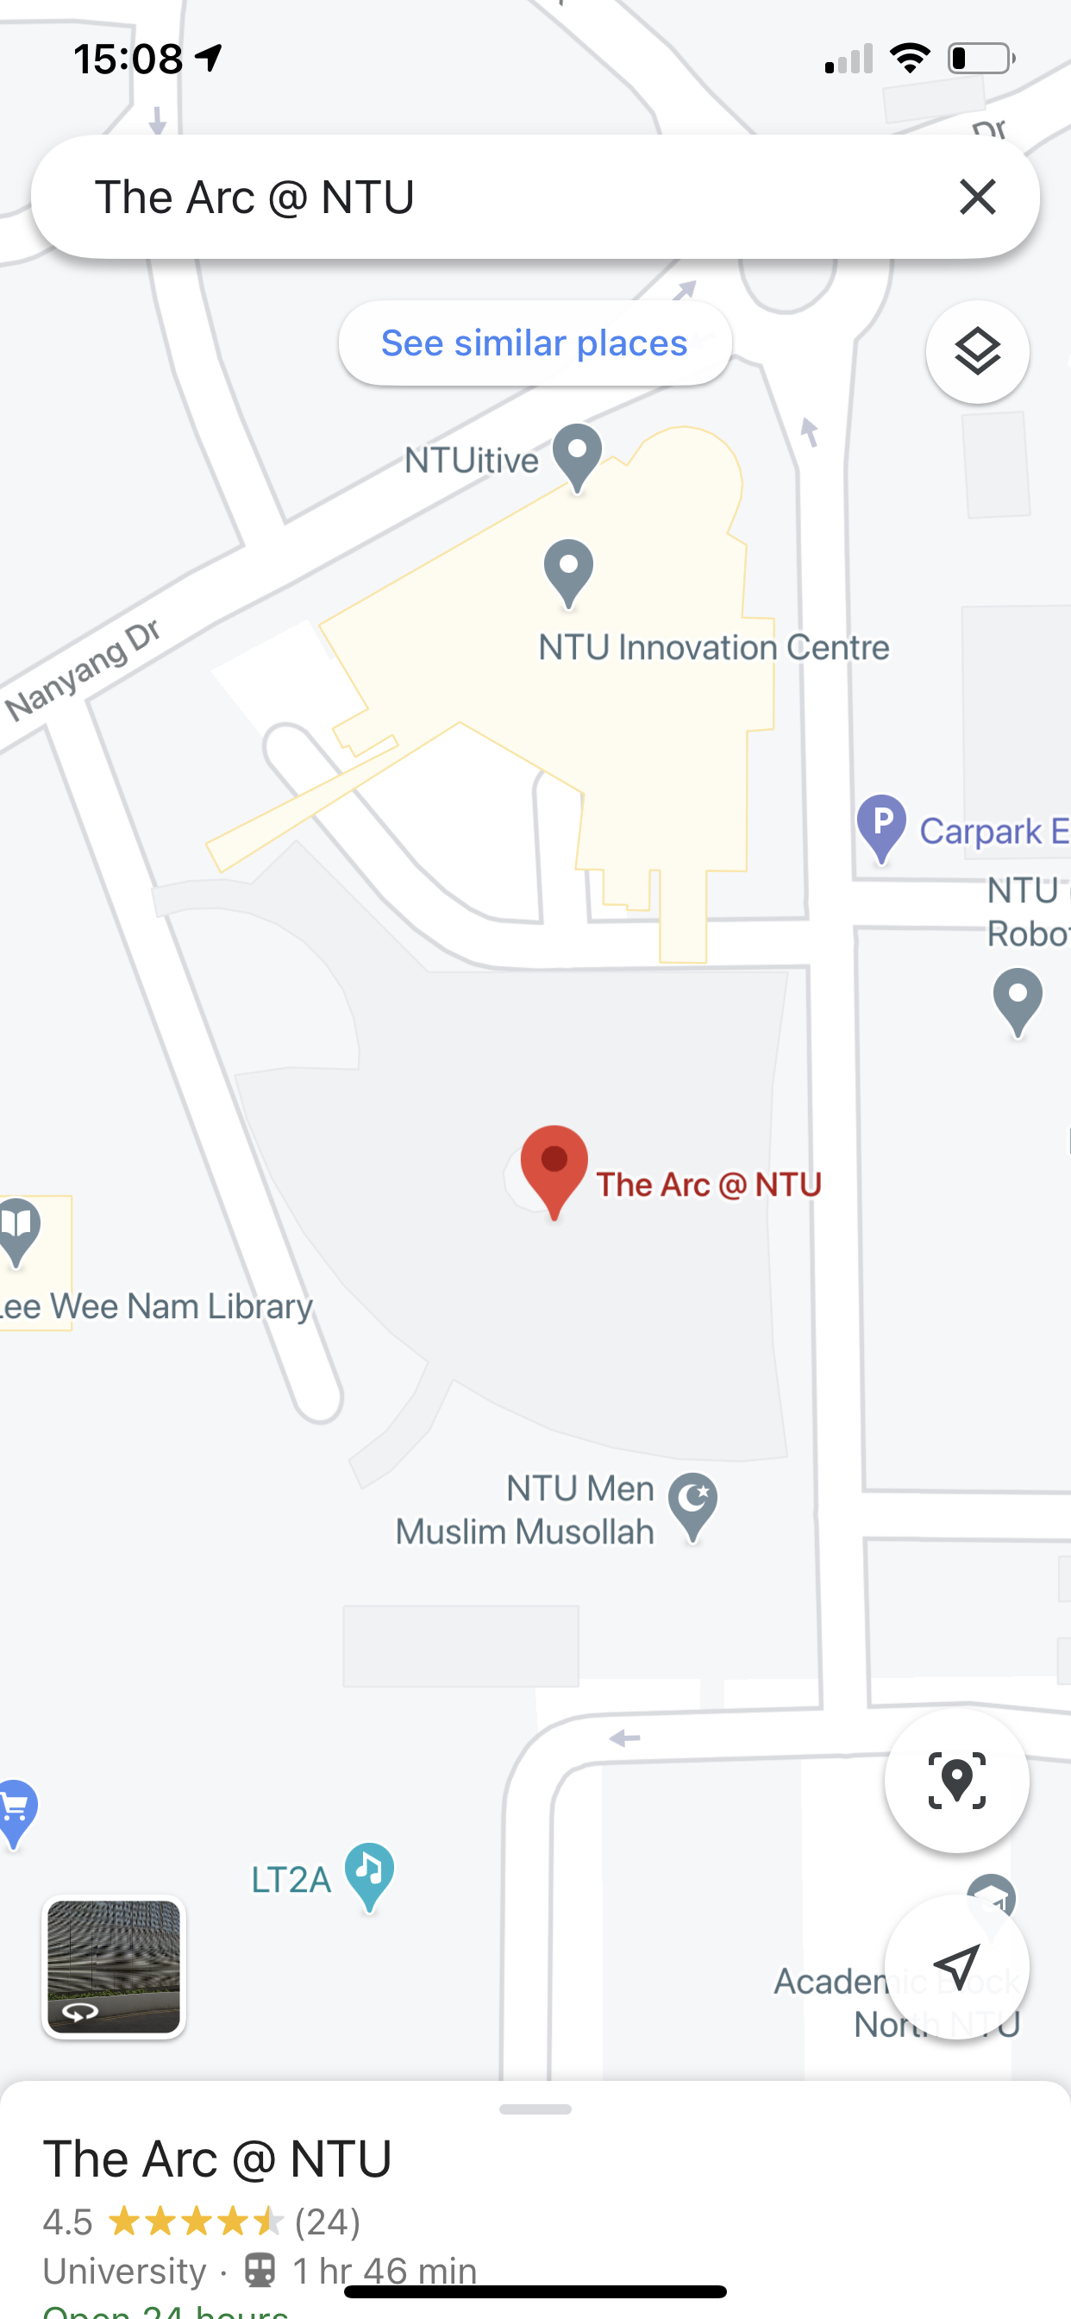














Get current location button
Menu button
START:
Search or click for current location >>
Swap start and end location button
END:
Search destination
2. Home Screen
Overview of features
Search button
L2
Let’s click this button to go up to level 2!
Level-up button
Click anywhere to show features
L1
Fields to enter start & end location
Level indicator
B1
Level-up button
The Arc @ NTU
TR14, L1
Users can also use 2 fingers to rotate the map or pinch to zoom.
This is an example of object manipulation.
]
Zoom
Current location
Now, click here to zoom in!
Zooming out is automatic for demonstration purposes.
N
Compass
2D
View mode
15m
F
Scale
Recently visited tab
Swipe down button
Recently Visited
Scroll
Favorites
Favorites tab
Click anywhere to continue

Slide 4
START:
Search or click for current location >>
END:
Search destination
2. Home Screen
Overview of features
The Recently Visited and Favorites tab can be hidden by swiping down the tab, enabling the user to see a full view of the map.
L2
The Arc @ NTU
TR14, L1
N
15m
2D
F
Click to swipe down and close the tab
Recently Visited
Favorites
Click anywhere to continue

Slide 5


START:
Search or click for current location >>
END:
Search destination
2. Home Screen
Overview of features
The Recently Visited and Favorites tab are some shortcuts the users can use to get directions to respective locations.
Users can scroll the tab which will show up to 4 locations and the last circle showing , indicating “More”.
Clicking the circles will direct the user the navigation page (slide 24), but we will not demonstrate it here.
L2
The Arc @ NTU
TR14, L1
N
2D
Click to scroll the Recently Visited tab
15m
F
Recently Visited
Click to expand the Favorites tab
Click to scroll the Favorites tab
Favorites

Slide 6





FAVOURITES
Undo
START:
Booklink removed from Favorites!
Search or click for current location >>
Search favorites or destination
Notification pops up, user can click undo reverse deletion
END:
Search destination
3. Favorites
Managing favorites
Favorites
Edit
Users can edit favorites here.
Click here to edit
Click location to get directions
Connect71
Here, users can manage their favorites – add or delete. A notification will show when a location has been removed from favorites. User can undo deletion or click the Recycle Bin icon
to recover it.
L2
SCSE Lounge
The Arc @ NTU
TR14, L1
Paik’s Bibim
N
McDonald’s
Click anywhere to show features
2D
15m
LWN Library
F
Users can add favorite locations here
Recently Visited
Booklink
Click here to remove Booklink from favorites
Add
Click here to access Recycle Bin for recovery
Favorites

Slide 7
Click to go back
FAVOURITES
Undo
START:
Search or click for current location >>
Booklink recovered from Bin!
Search Recycle Bin or destination
Notification pops up, user can click undo reverse deletion
END:
Search destination
3. Favorites
Managing favorites
Recycling Bin
Edit
Recycled items will be deleted in 30 days.
Booklink
Recover
Click to recover Booklink from Recycling Bin
Here, users can manage their favorites – add or delete. A notification will show when a location has been removed from favorites. User can undo deletion or click the Recycle Bin icon
to recover it.
L2
N4 TR11
Recover
The Arc @ NTU
TR14, L1
N
Click anywhere to show features
2D
15m
F
Recently Visited
Favorites

Slide 8
Click to go back
START:
Search or click for current location >>
Search favorites or destination
END:
Search destination
3. Favorites
Managing favorites
Favorites
Edit
Click location to get directions
Connect71
Here, users can manage their favorites – add or delete. A notification will show when a location has been removed from favorites. User can undo deletion or click the Recycle Bin icon
to recover it.
L2
SCSE Lounge
The Arc @ NTU
TR14, L1
Paik’s Bibim
N
McDonald’s
15m
2D
LWN Library
F
Recently Visited
Booklink
Booklink is readded to Favorites
Add
Favorites

Slide 9

START:
Search or click for current location >>
END:
Search destination
4. Menu
Menu features
L2
Click to open the Menu tab
The Arc @ NTU
TR14, L1
N
15m
2D
F
Recently Visited
Favorites

Slide 10
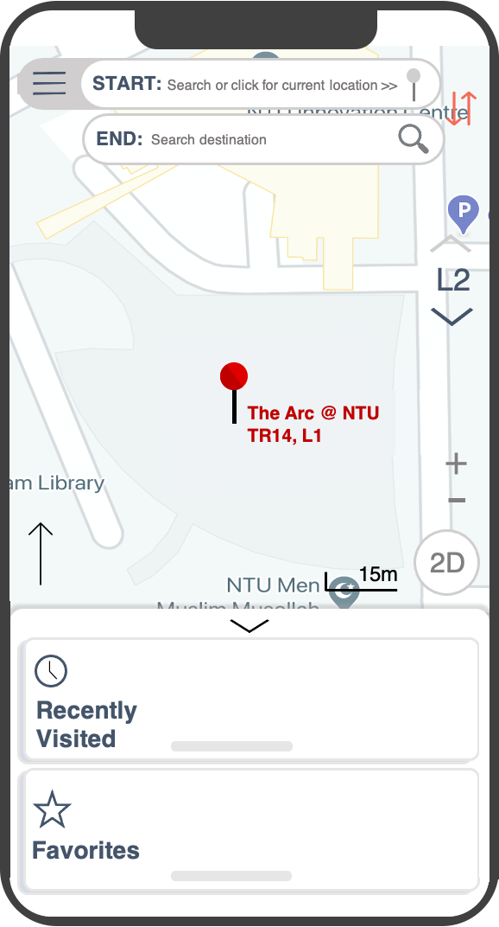








Menu
Settings
4. Menu
Menu features
Click to turn on wheelchair/stroller accessible mode.
This will prioritize routes via lifts and ramps.
Manage Route Preferences
Wheelchair/Stroller accessible mode
Users can customize their settings in the menu. This caters to universal usability.
Prioritize routes via lifts and ramps
Dark Mode
Click anywhere to continue
Notifications
Give me directions via notifications & alert me when I reach the destination
Here, users can enable “Wheelchair/Stroller accessible mode” to cater to users who need it.
N
Language
English (United Kingdom)
Aa
Text Size
A
A
Need help?
Help / FAQ
Contact Us

Slide 11








Menu
START:
Search or click for current location >>
Settings
END:
Search destination
4. Menu
Menu features
Manage Route Preferences
Wheelchair/Stroller accessible mode
Click to turn on dark mode.
This will darken the interface.
Users can customize their settings in the menu. This caters to universal usability.
Prioritize routes via lifts and ramps
Dark Mode
Click anywhere to continue
Notifications
Give me directions via notifications & alert me when I reach the destination
Next, users can enable dark mode so that they can use the application more comfortably in the dark.
Language
English (United Kingdom)
F
Aa
Text Size
A
A
Recently Visited
Need help?
Help / FAQ
Favorites
Contact Us
Click anywhere to continue

Slide 12
Menu
START:
Search or click for current location >>
Settings
END:
Search destination
4. Menu
Menu features
Manage Route Preferences
Wheelchair/Stroller accessible mode
Click again to turn off dark mode
Users can customize their settings in the menu. This caters to universal usability.
Prioritize routes via lifts and ramps
Dark Mode
Click anywhere to continue
Notifications
The Arc @ NTU
TR14, L1
Give me directions via notifications & alert me when I reach the destination
Users can also change the language. This is to cater to the diversity in cultures of the user.
A drop-down menu with the language options will appear, giving the users a choice limitation.
Click again to open the drop-down menu
Language
English (United Kingdom)
F
Aa
Text Size
A
A
Recently Visited
Need help?
Help / FAQ
Favorites
Contact Us

Slide 13
Menu
START:
Settings
Search destination
4. Menu
Menu features
Manage Route Preferences
Wheelchair/Stroller accessible mode
Users can customize their settings in the menu. This caters to universal usability.
Prioritize routes via lifts and ramps
Dark Mode
Click anywhere to continue
Notifications
Give me directions via notifications & alert me when I reach the destination
Users can also change the font size with the font size slider.
Senior users that may not be able to see small texts may want to size up their font sizes.
Click again to close the drop-down menu
Language
English (United Kingdom)
Click here to “slide” up the slider to increase font size
Chinese (Simplified)
Aa
Text Size
A
Bahasa Melayu
A
Recently Visited
தமிழ் மொழி
Need help?
Help / FAQ
Favorites
Contact Us

Slide 14
Menu
Menu
START:
Search or click for current location >>
Settings
Settings
END:
Search destination
4. Menu
Menu features
Manage Route Preferences
Manage Route Preferences
Wheelchair/Stroller accessible mode
Wheelchair/Stroller accessible mode
Users can customize their settings in the menu. This caters to universal usability.
Prioritize routes via lifts and ramps
L2
Prioritize routes via lifts and ramps
Dark Mode
Dark Mode
Notifications
The Arc @ NTU
TR14, L1
Notifications
Give me directions via notifications & alert me when I reach the destination
Give me directions via notifications & alert me when I reach the destination
Users can also change the font size with the font size slider.
Senior users that may not be able to see small texts may want to size up their font sizes.
Language
Language
2D
15m
English (United Kingdom)
F
Aa
Text Size
Text Size
A
A
Recently Visited
Need help?
Need help?
Help / FAQ
Help / FAQ
Favorites
Contact Us
Contact Us
Click anywhere to continue

Slide 15
Menu
Menu
START:
Search or click for current location >>
Settings
Settings
END:
Search destination
4. Menu
Menu features
Manage Route Preferences
Manage Route Preferences
Wheelchair/Stroller accessible mode
Wheelchair/Stroller accessible mode
Users can customize their settings in the menu. This caters to universal usability.
Prioritize routes via lifts and ramps
L2
Prioritize routes via lifts and ramps
Click here to close the menu tab
Dark Mode
Dark Mode
Notifications
The Arc @ NTU
TR14, L1
Notifications
Give me directions via notifications & alert me when I reach the destination
Give me directions via notifications & alert me when I reach the destination
Users can also change the font size with the font size slider.
Senior users that may not be able to see small texts may want to size up their font sizes.
Language
Language
2D
15m
English (United Kingdom)
Click here to “slide” up the slider to decrease font size
F
Aa
Text Size
Text Size
A
A
Recently Visited
Need help?
Need help?
Help / FAQ
Help / FAQ
Favorites
Contact Us
Contact Us

Slide 16
Menu
START:
Search or click for current location >>
Settings
END:
Search destination
4. Menu
Menu features
Manage Route Preferences
Wheelchair/Stroller accessible mode
Users can customize their settings in the menu. This caters to universal usability.
L2
Prioritize routes via lifts and ramps
Dark Mode
Notifications
The Arc @ NTU
TR14, L1
Give me directions via notifications & alert me when I reach the destination
N
Language
2D
15m
English (United Kingdom)
F
Aa
Text Size
A
A
Recently Visited
Need help?
Help / FAQ
Favorites
Contact Us

Slide 17


START:
The Arc TR14
Search or click for current location >>
END:
Search destination
5. Search
Entering start & end location
Click here to enter the current location as start location
Click to continue
L2
Clicking the pin will enter the current location as the starting point, and the pin will be highlighted red. The map will also recenter to the user’s location (at L1).
L1
Click here to enter the destination
The Arc @ NTU
TR14, L1
N
15m
2D
F
Recently Visited
Favorites

Slide 18





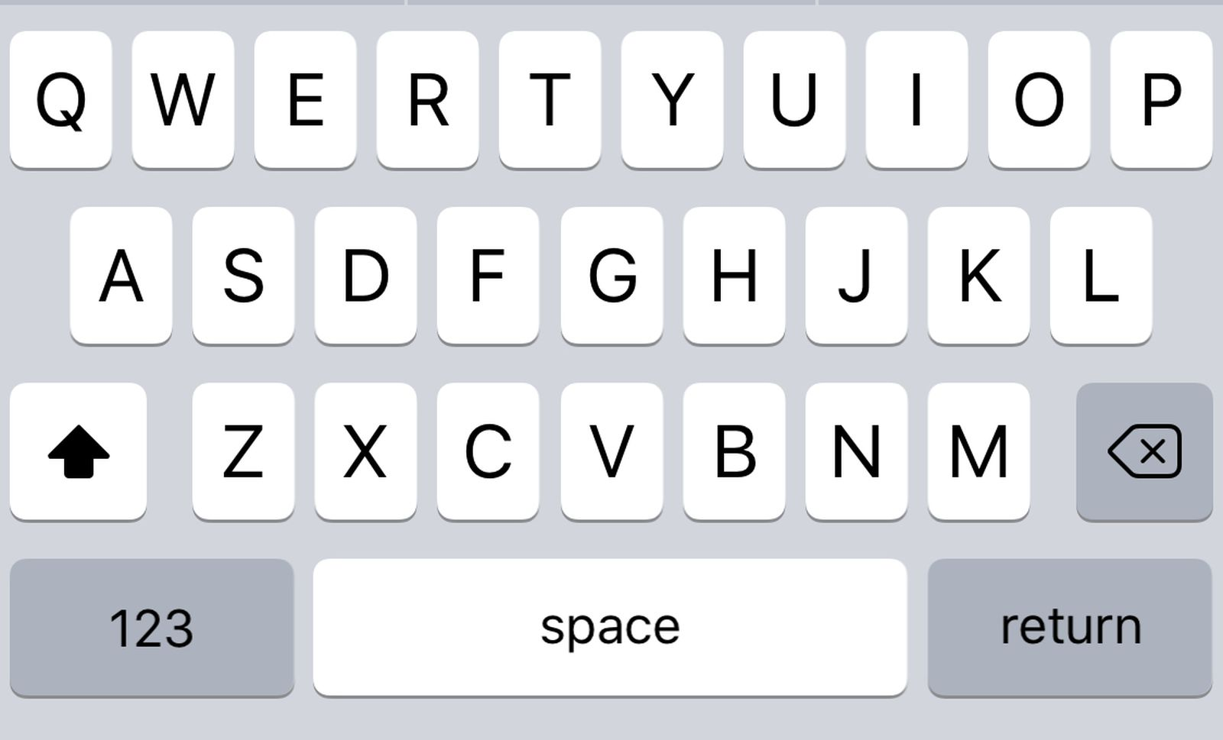
START:
The Arc TR14
END:
The Art LT4
5. Search
Searching with Speech Recognition via Microphone
Clear
Your search did not find any matches.
Did you mean:
RECENT SEARCHES
North Spine LT2A
Click here to clear search field
The Arc LT
Oops! Seems like this is not what we are searching for!
North Spine LT2A
L2
Prime Supermarket
North Spine LT4
If searches are invalid, clarification of top 3 relevant searches will be shown for the users to choose.
Connect71
South Spine LT4
Click the microphone to start recording destination
The Arc @ NTU
TR14, L1
Voice searches might not be too accurate, users can clear their search bar and retype the destination.
Listening
Listening
15m
2D
F
Click the keyboard to start typing destination
Recently Visited
B
Favorites

Slide 19

START:
The Arc TR14
Let’s try swapping the start and end locations!
Click here to swap locations
END:
The Arc LT4
The Arc LT
5. Search
Searching with Text Input via Keyboard
The Arc LT
Clear
Your search did not find any matches.
Did you mean:
RECENT SEARCHES
Click to start navigation
North Spine LT2A
The Arc LT
Once destination is valid, search button turns blue – indicating that it can be clicked
North Spine LT2A
L2
Prime Supermarket
North Spine LT4
If searches are invalid, clarification of top 3 relevant searches will be shown for the users to choose.
Connect71
South Spine LT4
The Arc @ NTU
TR14, L1
Click here to choose the correct destination
Listening
15m
2D
F
Recently Visited
B
Favorites

Slide 20


FAVOURITES
Undo
START:
The Arc TR14
The Arc LT added to Favorites!
Click here to swap locations again
END:
The Arc LT
5. Search
Adding search location to Favorites
The Arc LT
Click to start navigation
North Spine LT2A
Click here to add destination to Favorites
L2
When a location is added to Favorites, the star is filled blue and a notification will pop up, giving feedback to the user that the location has been added to Favorites.
The Arc @ NTU
TR14, L1
Listening
15m
2D
F
Recently Visited
B
Favorites

Slide 21
FAVOURITES
Undo
START:
The Arc LT removed from Favorites!
The Arc LT
END:
The Arc TR14
Click here to confirm search entry
5. Search
Removing search location from Favorites
The Arc LT
Click to start navigation
North Spine LT2A
Click here to remove destination from Favorites
L2
When a location is removed from Favorites, the star is unfilled and a notification will pop up, giving feedback to the user that the location has been removed from Favorites.
The Arc @ NTU
TR14, L1
Search button turns blue when a valid search is entered, indicating that it is clickable only when search is valid – preventing errors.
Listening
15m
2D
F
Recently Visited
B
Favorites

Slide 22
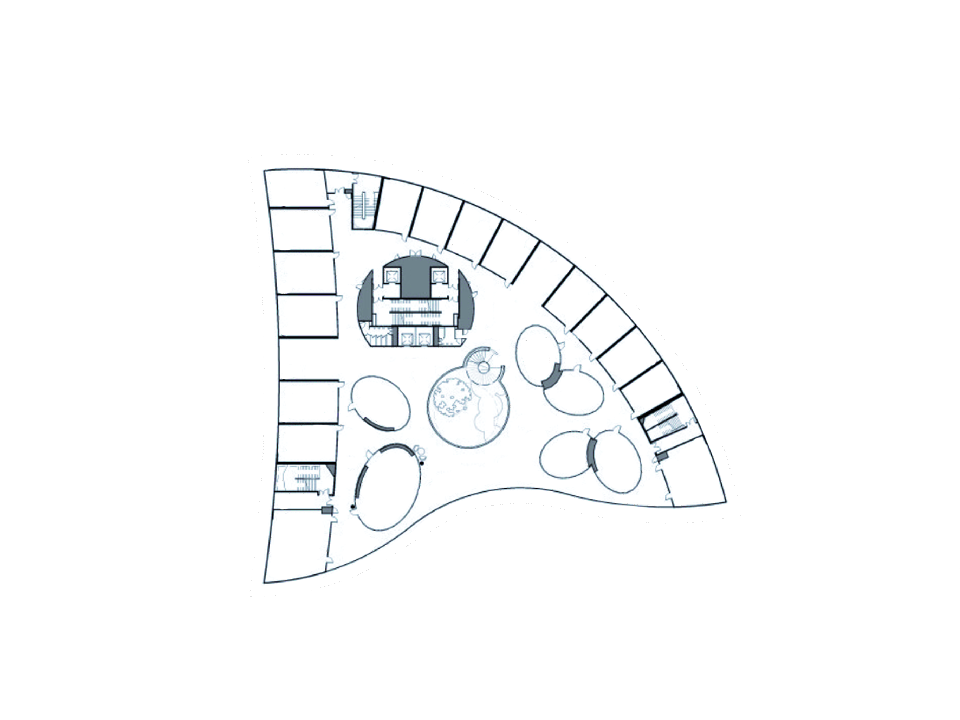

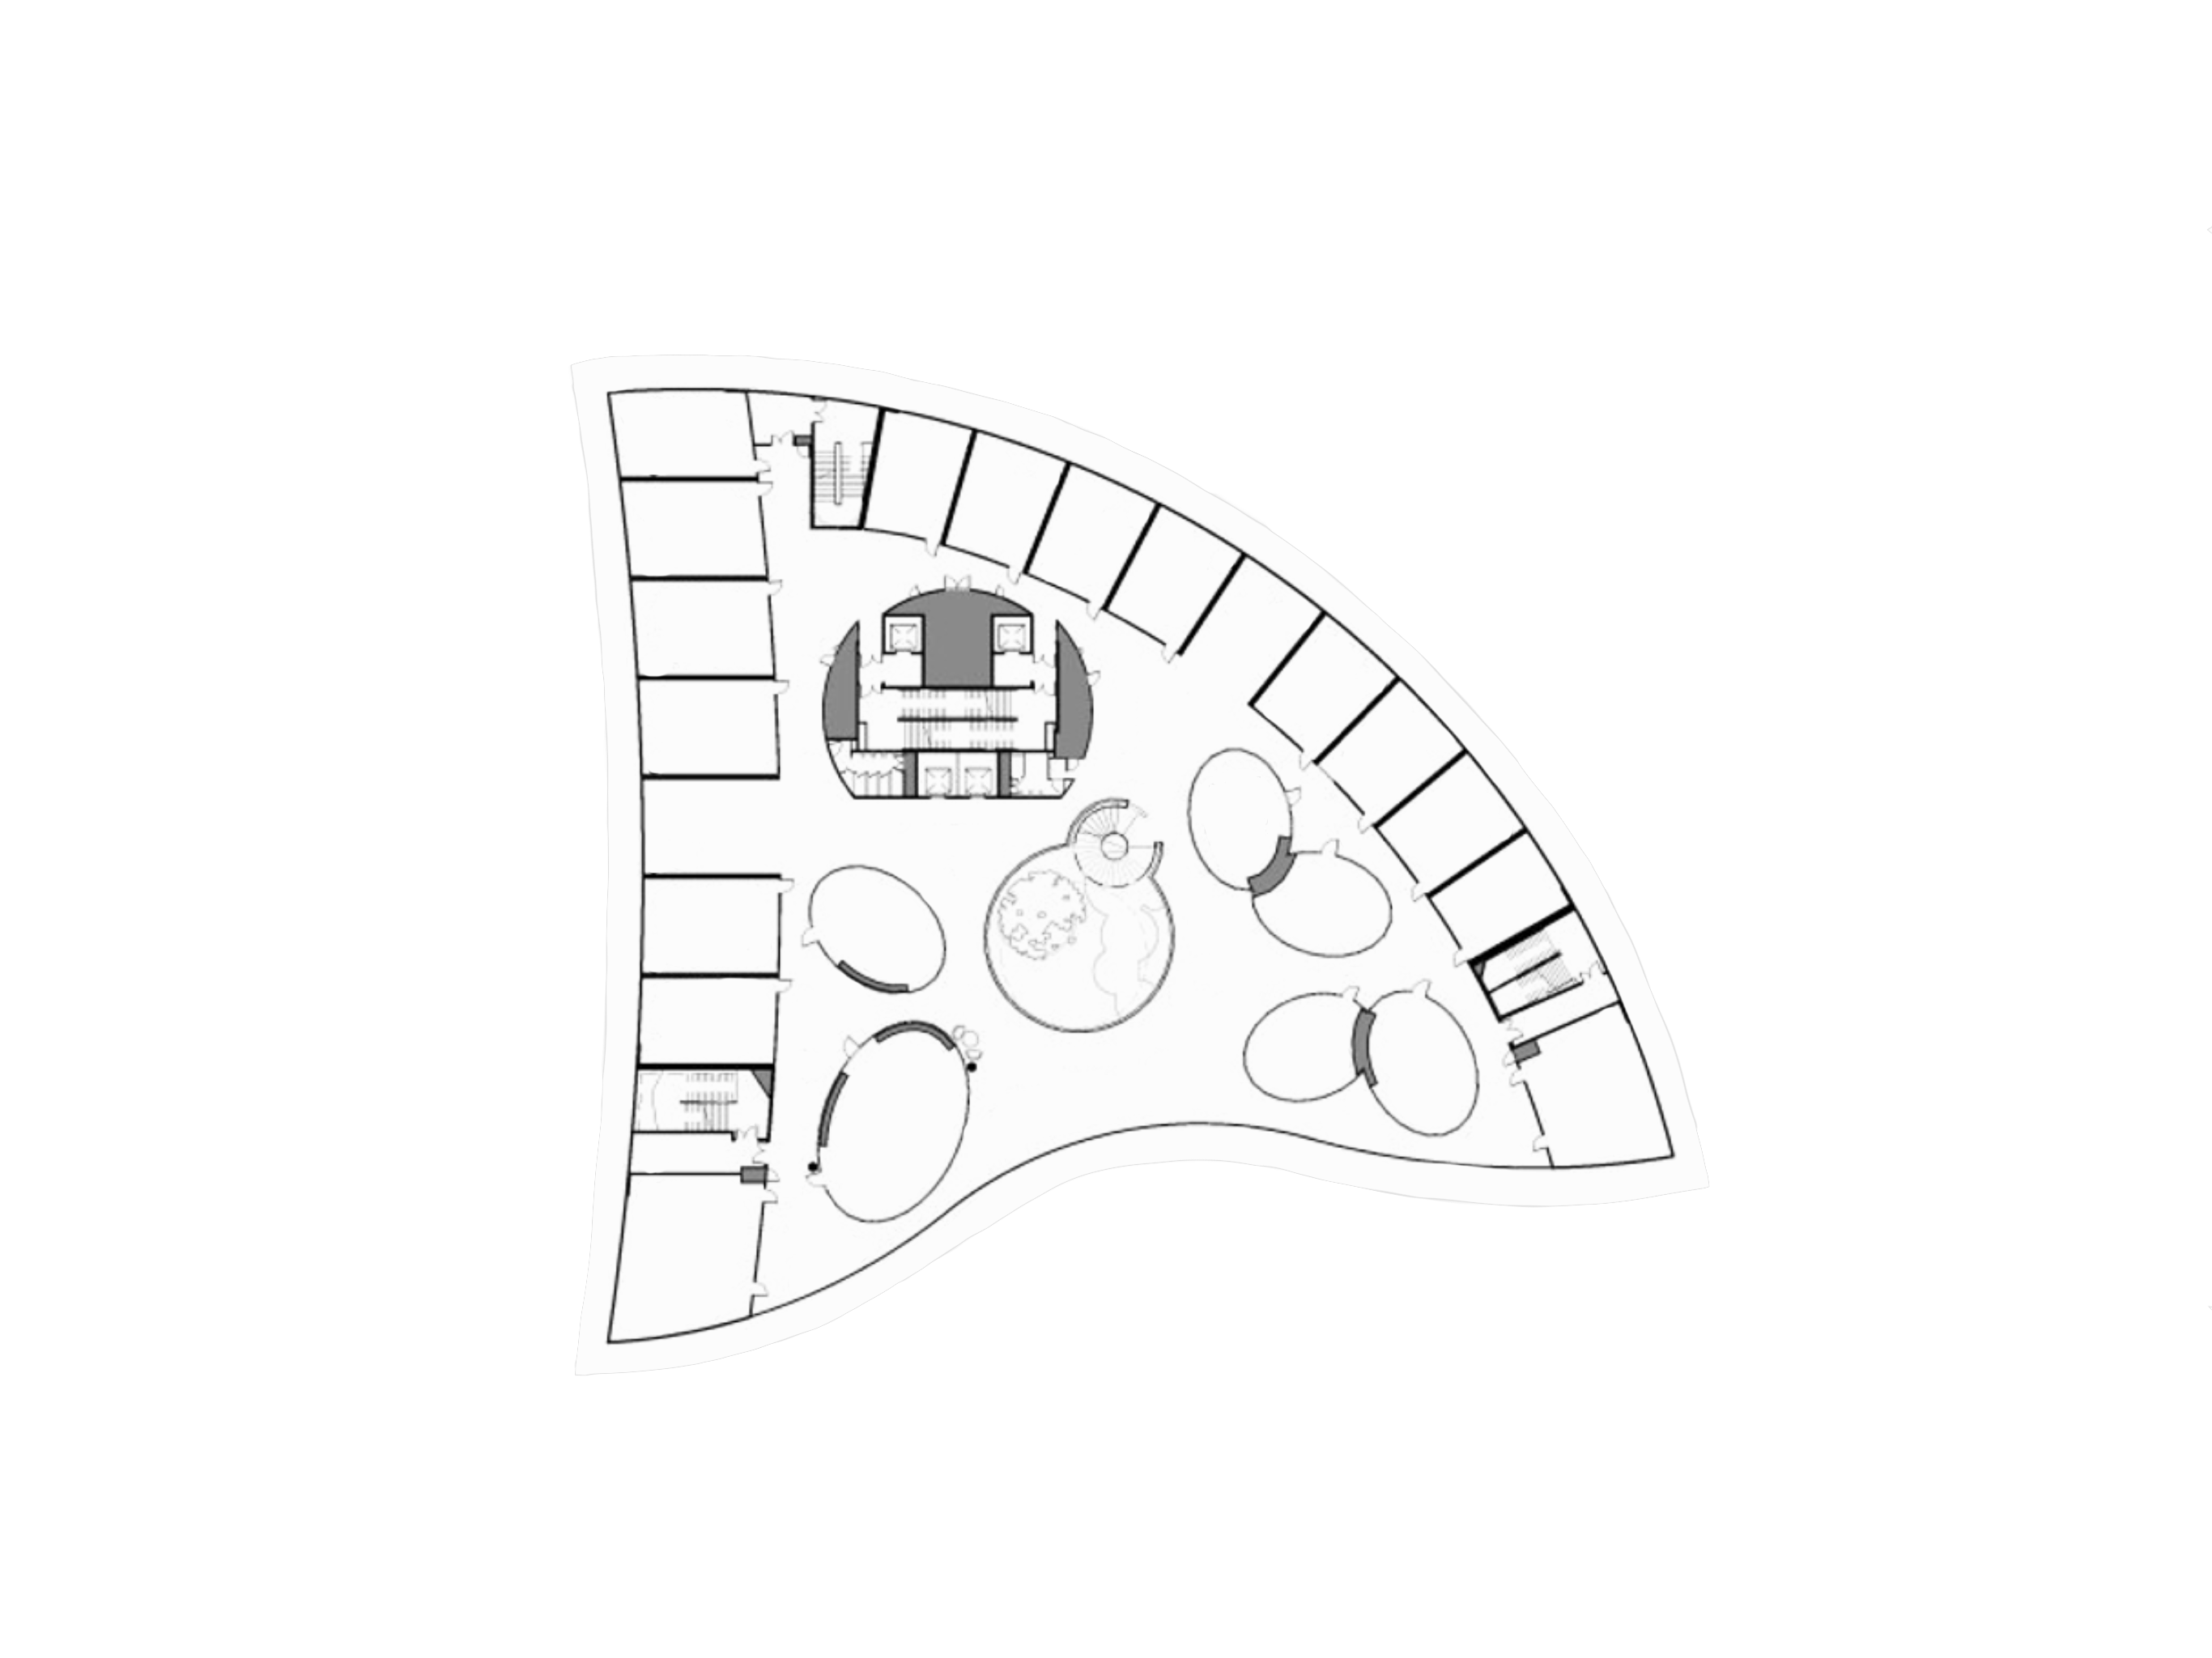
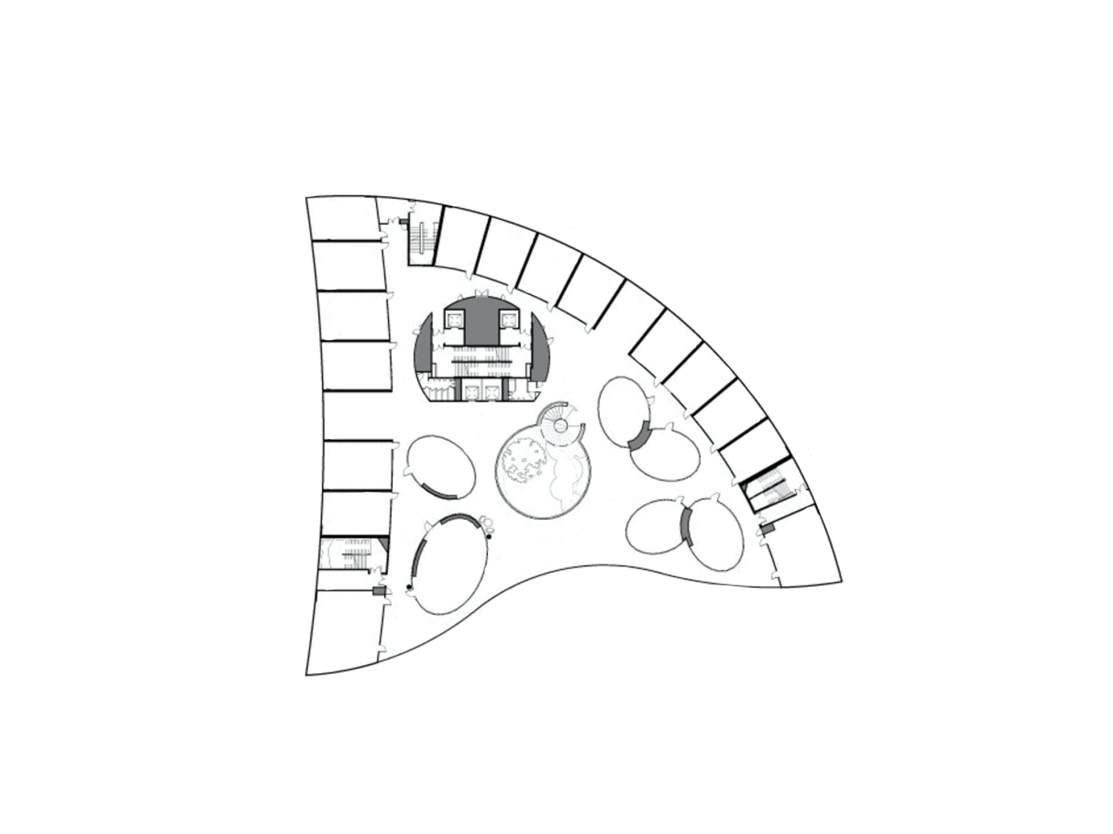






START:
The Arc TR14
END:
The Arc LT
6. Navigation Overview
Selecting route to take in Multi-Level view
Facilities icons
North Spine LT2A
Click anywhere to show features
L1
Top 2 routes will be shown for the user to choose which route to take.
Floorplan of building in aerial view
Level label
You are here
B1
Multi-level mode
Your destination
Route summary
Preferred will be shown if we turned on wheelchair/stroller accessible mode
Button to start navigating
N
Mode of going up and down levels
Click here to see Route 1 animation
Click here to see Route 2 animation
Distance to destination
F
View routes (click to show route)
Route 1
Route 2
To show full directions
Click here to expand Route 1 details
Preferred
Alternative
100m
115m
Estimated time of arrival
To show more available routes
ETA: 5 MIN
ETA: 7 MIN
Show more routes

Slide 23
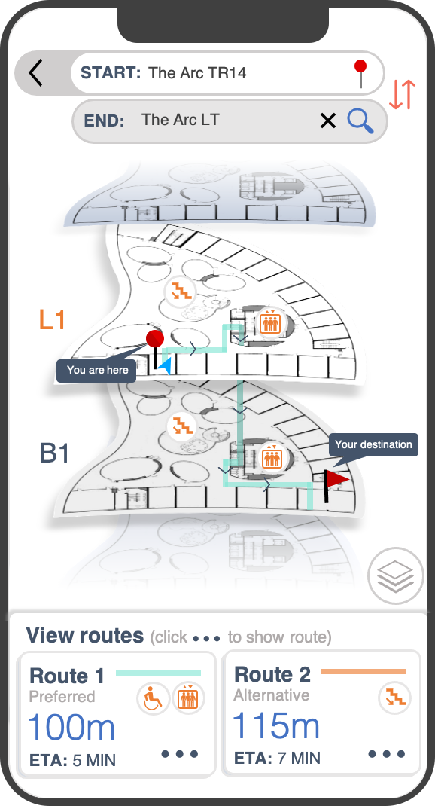





START:
The Arc TR14
END:
The Arc LT
Click here to start navigating
7. Starting navigation
Route preview
Button to start navigating
Route 1
100m
GO
Here, specific directions are given to the user for the user to have a gauge of the steps to take to get to the destination.
ETA: 5 MIN
Route details
5m
Exit TR14
10m
Head South and turn right
Directions
Click anywhere to show features
35m
Turn left towards the lift
Current step
B1
Go to Basement 1
Action icons
0m
Exit the lift and turn left
Distance until this step
15m
Turn left and head West
35m
Turn right and head North
Progress Bar
0m
Your destination:
The Arc LT
Destination

Slide 24





2D
START:
The Arc TR14
Distance to the current step
END:
The Arc LT
8. 2D Navigation
Route preview
5m
Distance to the next step
Exit TR14
F
Head South and turn right
10m
Route 1
100m
This is the start of the navigation. User will start navigation in 2D mode. Screen will change to show the next level as users go up or down levels.
Current step
ETA: 5 MIN
L1
5m
Exit TR14
Current level
10m
Head South and turn right
Click here to close directions tab
Click anywhere to show features
35m
Turn left towards the lift
B1
Next step
This is so that users can anticipate their next turn
B1
Go to Basement 1
Click to enable speaker mode
Directions will be read aloud for users who may not be able to see their phone – caters to universal usability when users are ”temporarily disabled”
0m
Exit the lift and turn left
15m
Turn left and head West
Click here to try out 3D mode
35m
2D
Turn right and head North
N
12m
Directions tab
Users can refer to the full directions here to reduce short term memory
Click to ”slide” up directions tab
F
• 5 min
0m
You have reached your destination, The Arc LT!
Route 1
100m
Exit navigation button
Preferred
Swipe up for full directions

Slide 25


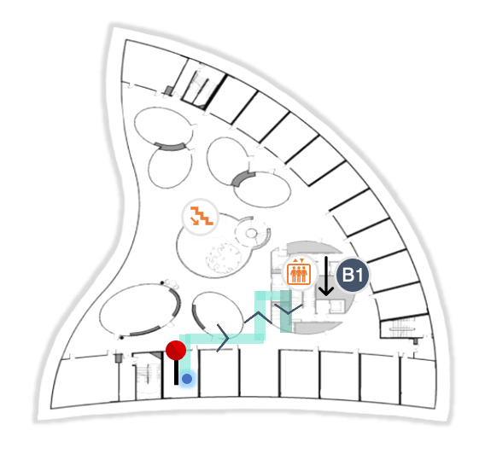

3D
START:
The Arc TR14
END:
The Arc LT
9. 3D Navigation
Step by step route instructions
5m
Exit TR14
Head South and turn right
10m
The Arc TR14
This is simulating the start of the route in 3D view. As the user moves, the view will change accordingly.
The 3D environment will be labeled so users will know their relative location.
L1
Action indicator “to exit room”
N
Click anywhere to show features
Surrounding labels
Click here to try out AR mode
1m
3D
F
Thumbnail overview of route
Users can gauge their next steps
• 5 min
Route 1
100m
Preferred
Swipe up for full directions

Slide 26


START:
The Arc TR14
END:
The Arc LT
10. AR Navigation
Step by step route instructions via Augmented Reality
5m
Exit TR14
Head South and turn right
10m
L1
This is similar to the 3D view, but using the device camera to display actual surroundings. As the user moves, the view will change accordingly.
The AR environment will also be labeled so users will know their relative location.
N
Click anywhere to show features
Click here to go back to 2D mode
1m
F
• 5 min
Route 1
100m
Preferred
Swipe up for full directions

Slide 27
START:
The Arc TR14
END:
The Arc LT
11. Navigation
Route progress
5m
Exit TR14
0m
Go to Basement 1
F
Head South and turn right
10m
Route 1
50m
Exit the lift and turn left
As users follow the directions, their progress will be seen on the route. The user location indicator will move and the route will darken when user has completed that step.
ETA: 3 MIN
L1
5m
Exit TR14
10m
Head South and turn right
Click here to close directions tab
Click anywhere to continue
35m
Turn left towards the lift
B1
B1
Go to Basement 1
0m
Exit the lift and turn left
User’s updated location
15m
Turn left and head West
35m
12m
2D
N
Turn right and head North
Click to ”slide” up directions tab
F
• 5 min
• 3 min
0m
You have reached your destination, The Arc LT!
50m
Route 1
100m
Preferred
Swipe up for full directions

Slide 28



START:
The Arc TR14
END:
The Arc LT
12. Arrival
Reaching the destination
0m
Your destination is on
the right
5m
Turn right and head North
Your destination is on the right
0m
As the user reaches the destination in 3D or AR mode, there will be a flag seen on the screen, indicating that the destination is reached.
The Arc LT
L1
Click anywhere to continue
You have reached your destination!
Exit
navigation?
Cancel
OK
OK
Cancel
Click here to press ok
N
12m
3D
F
Click here to exit navigation
• 0 min
Route 1
5m
Preferred
Swipe up for full directions

Slide 29
START:
Search or click for current location >>
END:
Search destination
13. Back to Home
Location updated
L2
User’s location has been updated on the map, users may exit the application.
L1
B1
N
The Arc @ NTU
The Arc LT, B1
15m
2D
F
Recently Visited
Favorites

Slide 30
14. Exit Screen
Thank you for using
iNavigate
AN INDOOR NAVIGATION SYSTEM

